Slide 1
Hands-on #1 Build basic p2pServer application and connect

Slide 2

Agenda
1
Hands-on presentation
4
Step 3 : Code generation and user application code
5
“bonus track” : Adding logs
2
Step 1: STM32CubeMX/STM32CubeIDE initialization for STM32WBA Nucleo board
3
Step2 : Advertising and BLE application configuration and explanation

Slide 3
Hands-on presentation

Slide 4

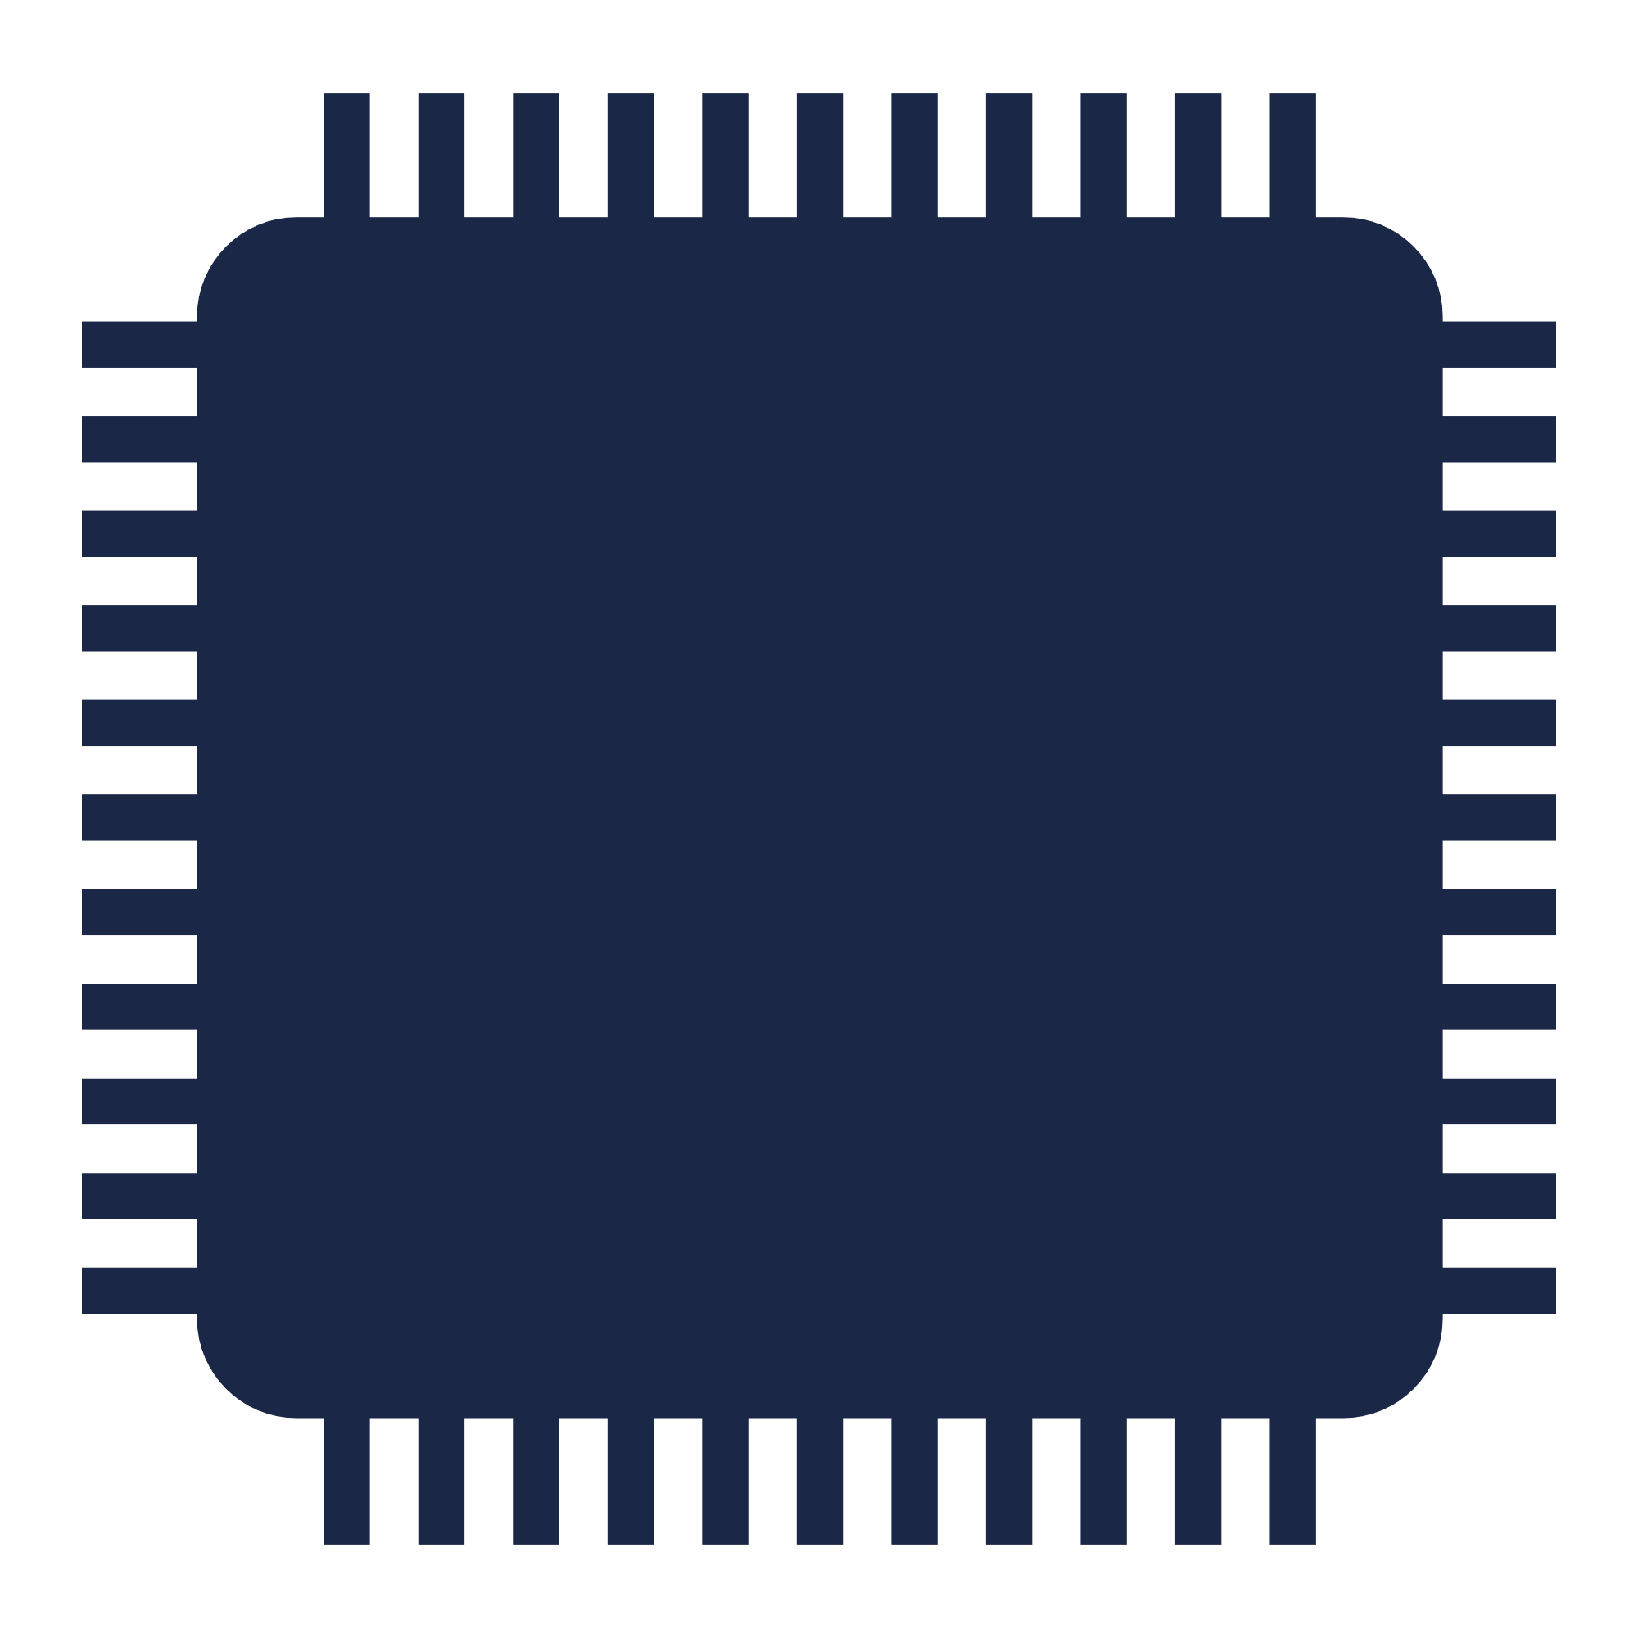
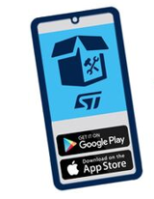
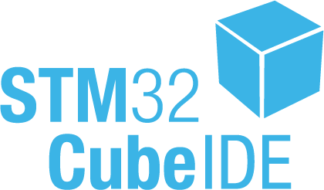



Purpose
The purpose is to start from WBA55 chipset level and build a basic server (p2pServer) application using STM32CubeMX/STM32CubeIDE
In this first part, focus is to get device visible and connectable from my smartphone
system init
HW init
STM32WBA55
Bluetooth® Low Energy configuration
Bluetooth® Low Energy peripheral advertising
Unpack NUCLEO-WBA55, plug to laptop,
install your favorite ST BLE ToolBox App and Let’s start !

Slide 5

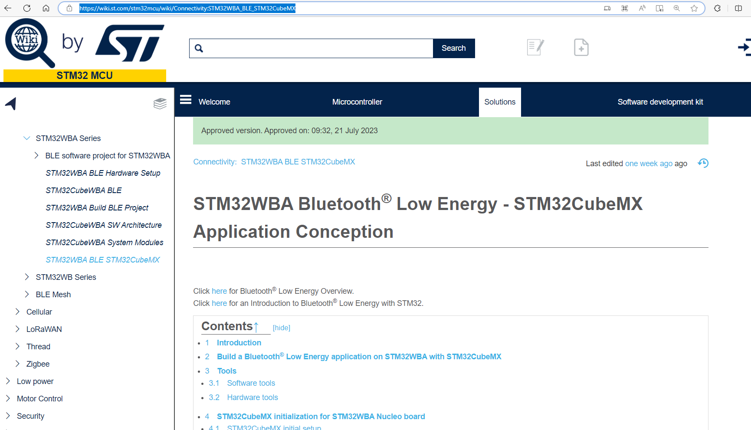
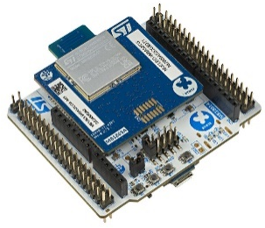
Source
Hands-on based on
https://wiki.st.com/stm32mcu/wiki/Connectivity:STM32WBA_BLE_STM32CubeMX
step by step guideline to build a Bluetooth® Low Energy peripheral application
Bluetooth® Low Energy peripheral
exposing data to central device

Slide 6
Legend
Slides including following symbol are purely theoretical ones
Source code for development is included inside blue boxes
HAL_Delay(500);

Slide 7
Step 1 : STM32CubeMX initialization for STM32WBA Nucleo board

Slide 8

STM32CubeMX capabilities
STM32CubeMX : “Standalone version” or “integrated version” into STM32CubeIDE allow to start design within 3 options
1
Example application
complete application running over NUCLEO
2
Board level
all the hardware is already configured (NUCLEO_WBA55)
3
Chipset level
require to configure your HW (PCB) & your application
STM32WBA wiki page focus
Hands-on focus. As customer let’s build my own App
STM32CubeMX can be standalone application but also part of STM32CubeIDE

Slide 9
STM32CubeMX design from chipset level complete journey
STM32CubeMx initialisation for STM32WBA Nucleo board
STM32WBA IPs & peripherals configuration
Clock Tree configuration
BLE configuration : Advertising, Service, Characteristic
Code generation & application code management over CubeIDE
Hands-on
Focus

Slide 10

STM32CubeMx design from chipset level Hands-on focus (1/2)
3
Chipset level
require to configure your HW (PCB) & your application
To ease Hands-on session use Hands-on_WS_WBA55.ioc
All HW IPs & required peripheral to use RF are already initialized : NVIC, RNG, RCC,...
Thanks to Hands-on_WS_WBA55.ioc let’s focus on BLE application design
Copy Hands-on_WS_WBA55.ioc on your local repository : example : C:\users\...\STM32WBA_WS\project

Slide 11
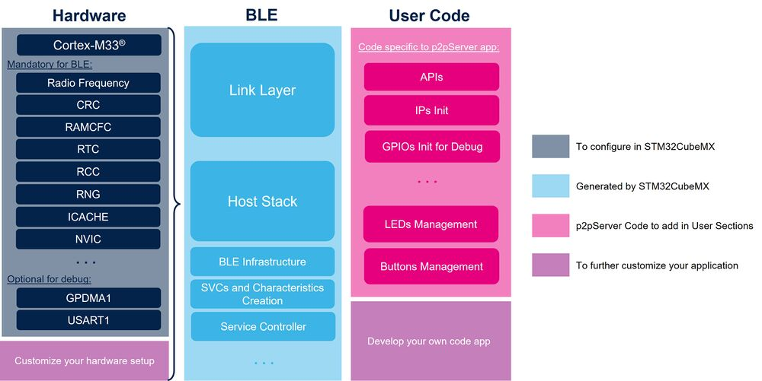
STM32CubeMx design from chipset level Hands-on focus (2/2)
Hands-On_WS_WBA55.ioc
Hands-on Focus

Slide 12
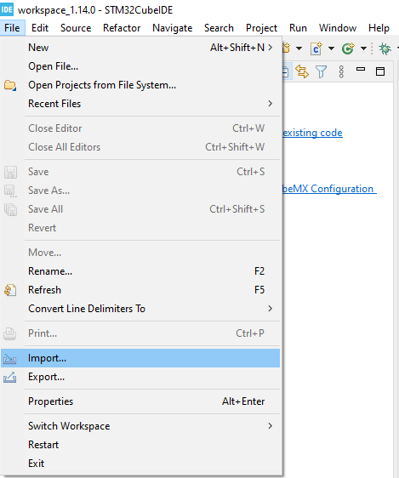
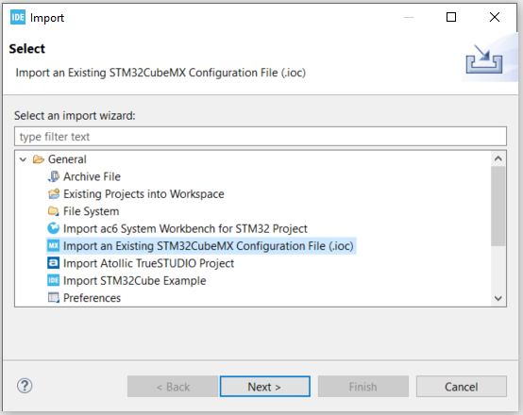
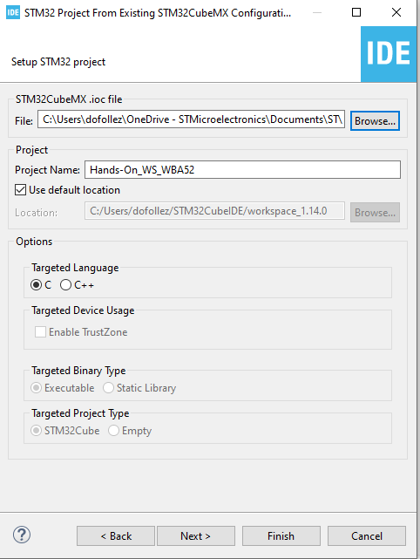

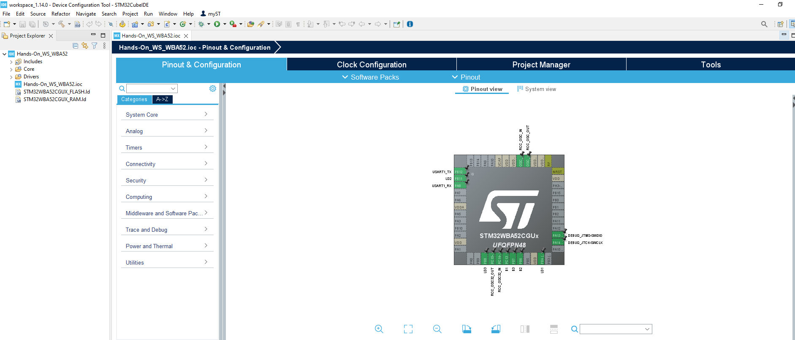
Open and Start STM32CubeIDE
1
5
2
3

Slide 13
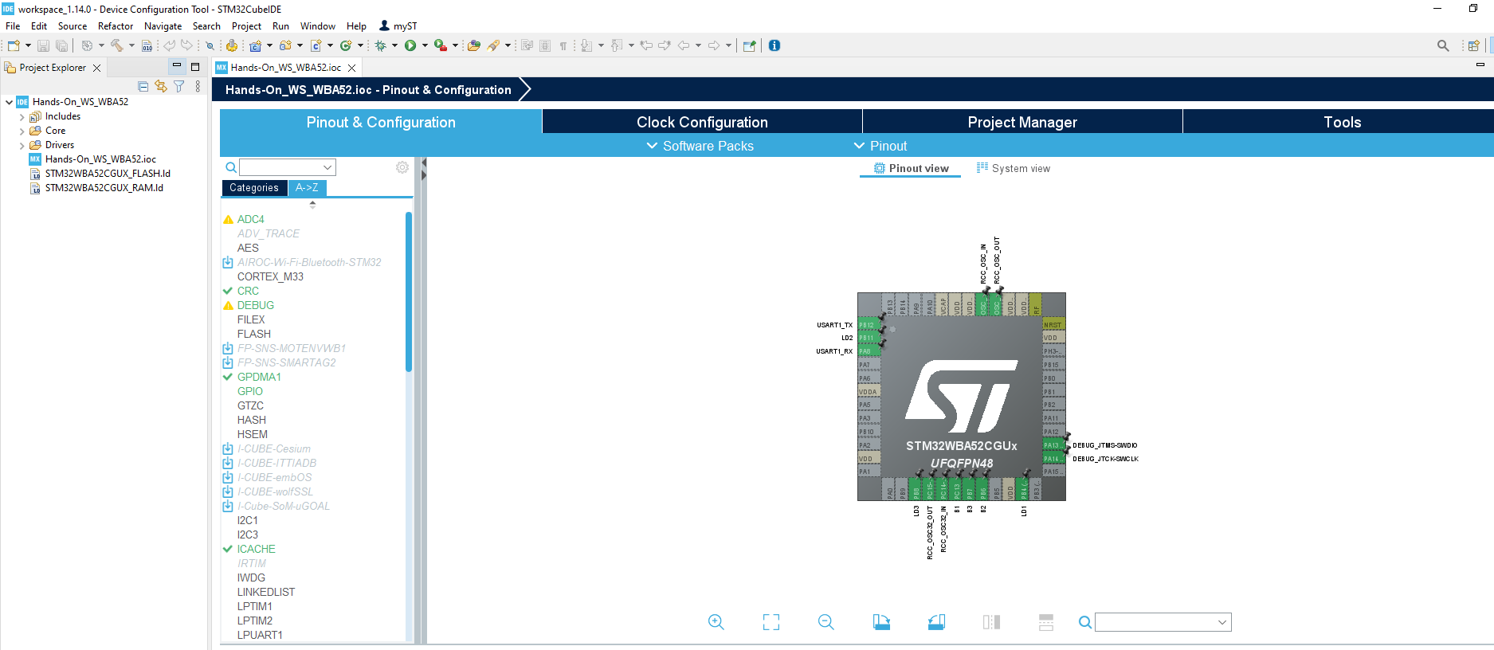
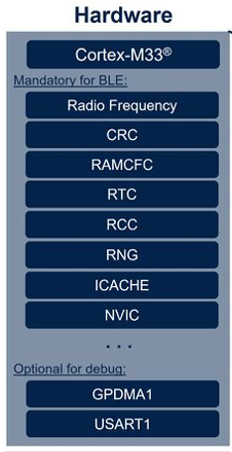
Peripherals in place to start BLE configuration !
Hands-On_WBA55.ioc
STM32WBA55CGUx5
Hands_On_WBA55.ioc
HW configuraton
enable STM32_WPAN (BLE middleware activation)

Slide 14
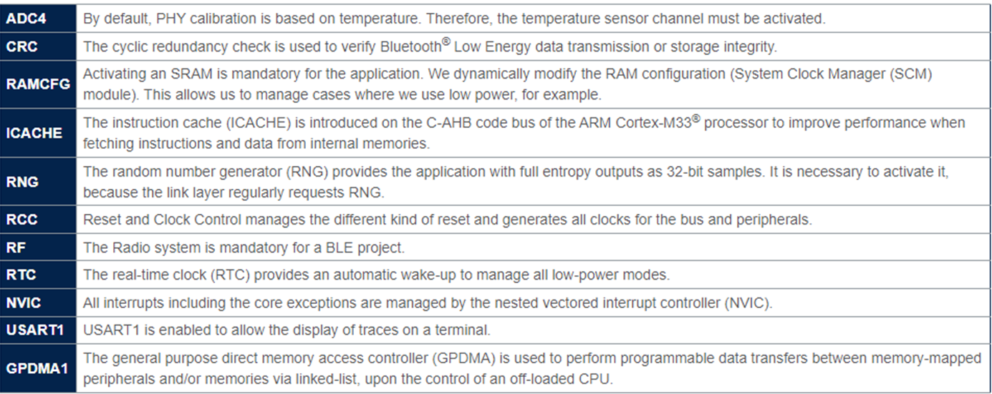
Peripherals in place to start BLE configuration ! Wiki explanations
https://wiki.st.com/stm32mcu/wiki/Connectivity:STM32WBA_BLE_STM32CubeMX
BLE activation
debug

Slide 15
Step2 : Advertising and Bluetooth® Low Energy GAP/GATT custom application configuration

Slide 16
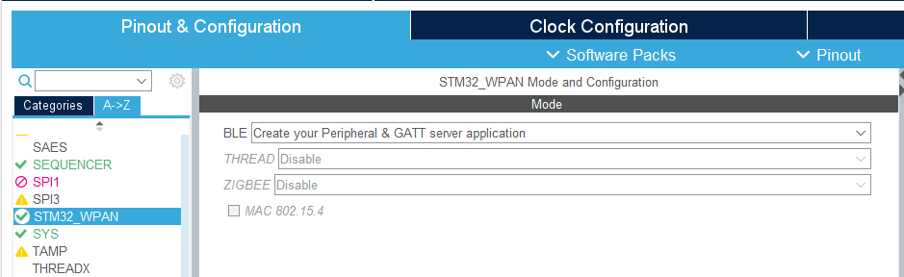
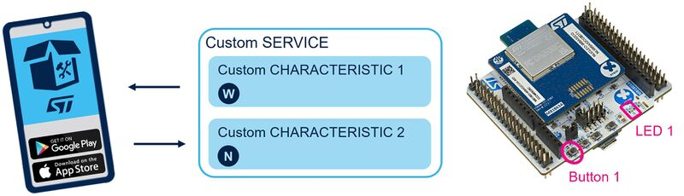
Enabling Bluetooth® Low Energy
2
1
Our Application is a peripheral server application.
Client
Server

Slide 17
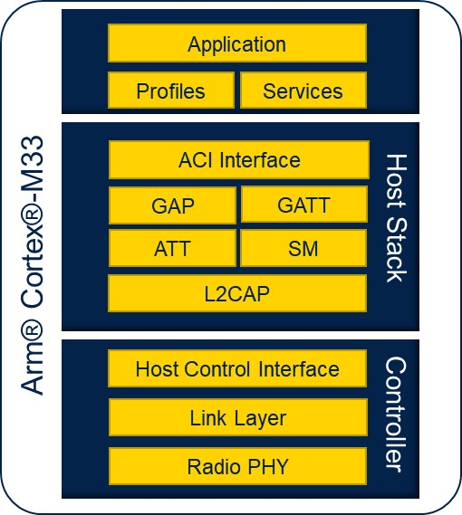
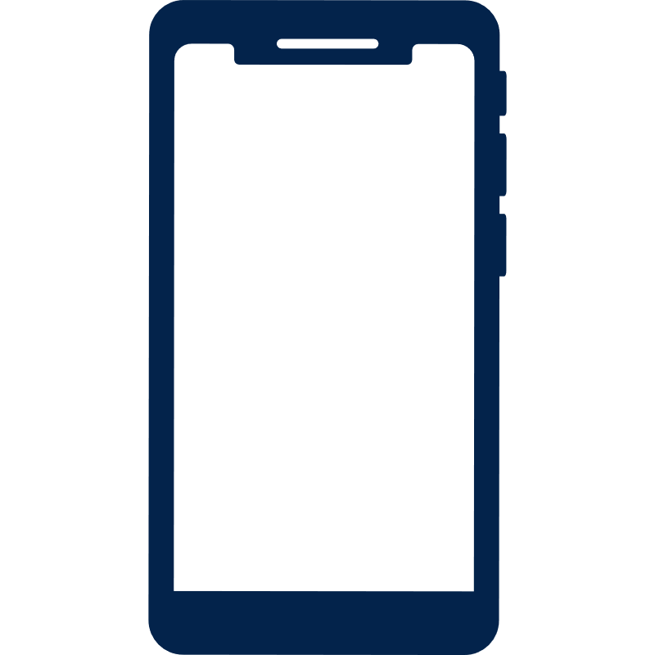

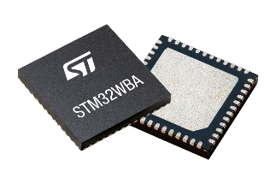
Bluetooth® Low Energy Connection roles vs. Data roles
Generic Access Profile (GAP)
Scanning
Advertising
« Hi I am here »
connection request
Central
Peripheral
Generic Attribute Profile (GATT)
Read/Write
ATT table
« I have data to share»
Client
Server
« I am looking for data »
In the general run of things….
a Central is acting as GATT Client, a peripheral as a GATT server

Slide 18
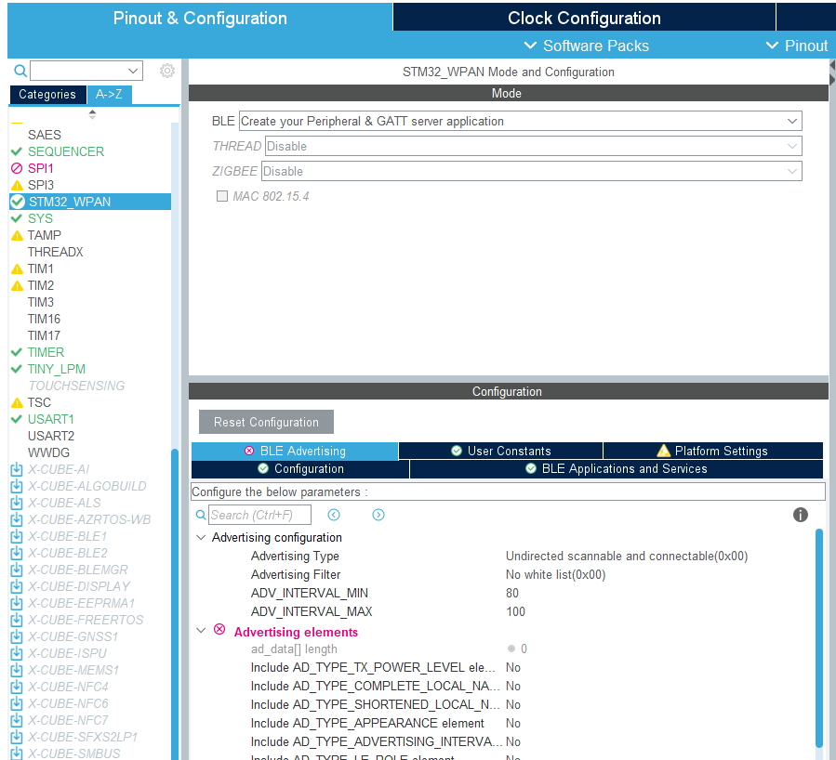
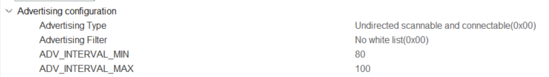
Advertising Configuration
Advertising Type
accept connection requests from any peer device
Advertising Filter
In general, used in case of Privacy.
Advertising Interval
Advertising set = (MIN+MAX)/2
Min & Max used in case of multi connections
Units : ms
For this session, let’s keep default values at this stage

Slide 19

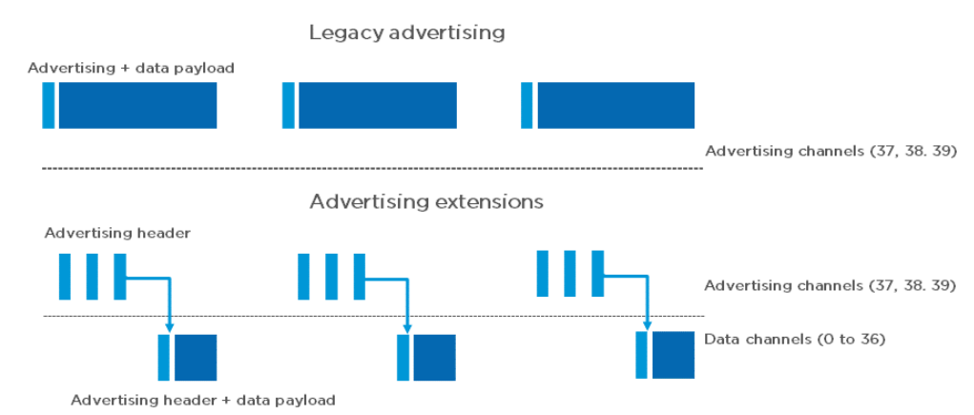
Advertising Configuration Legacy Advertising Interval
Advertising Interval
Advertising Interval
Advertising Interval
« Hi I am here »
Adv event
Adv event
Adv event
Adv event
ch 37 | ch 38 | ch 39
The advertising interval value ranges all the way from 20 milliseconds up to 10.24 seconds in small increments of 625 microseconds.
The advertising interval greatly impacts battery life and should be chosen carefully.
connectivity latency vs. power consumption efficiency
The advertising event is the slot where peripheral will be able to push for advertising data “Hello I am here – this is my name”
The advertising event is around ~3ms considering legacy advertising (31 bytes)
WBA5x supporting advertising extension to increase your advertising data
Thanks to adv extension , Periodic advertising supported
Notes:
Advertising extension : adv data up to 255 bytes, packet can be chaine up to 1650 bytes
Periodic Advertising as basis to support BLE Audio & Direction Finding (AoA/AoD) features
In future Periodic Advertising with Response (PAwR) will be supported, basis for coming ESL feature (BLE 5.4) (Electronic Shelves Label)

Slide 20
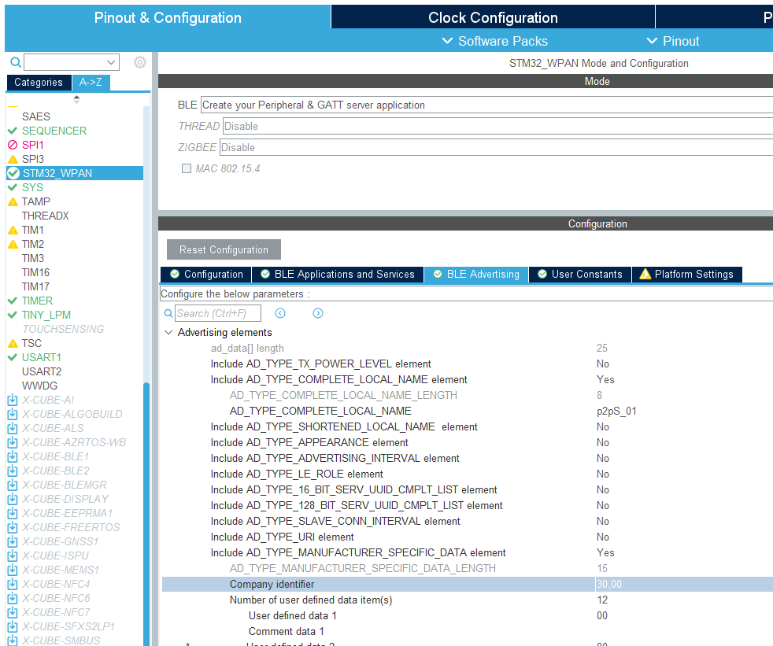

Advertising Elements Local Name
Local Name length = Local name + 1
1
As a server, our application will have to advertise waiting for connection request from a client.
Define here your “custom” local name part of advertising frame.
2
3
Local Name length must be < 11
CubeMx contraints
If not ST Toolbox potential crash

Slide 21
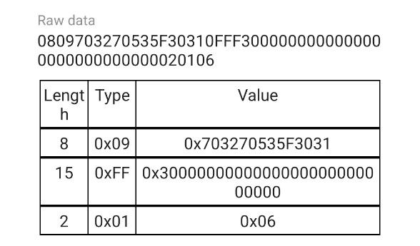
Advertising Elements Advertising PDU
header
(2 bytes)
payload
(0….37 bytes)*
Advertising PDU
device @
6 bytes
Payload – Advertising Data
(0….31 bytes)
The Advertising Data consists of one or more Advertising Data elements
AD Element/Type are listed at Bluetooth SIG website
AD Elements 1
AD Elements 2
AD Elements 3
…
Most commonly used AD elements :
0x01 = Flags (mandatory for connectable device)
0x09 = Complete Local Name
0xFF = Manufacturer Data
lenght
Ad Type
Data
0x08
0x09
«p2ps_01»
11
«my_device»
complete local name
Ad Type
You can push for what you want over the air ! All data need to be prefix using dedicated Ad Type
* up to 37 bytes in legacy advertising , up to 1650 in case of advertising extension (packet of 250 chained)

Slide 22
Advertising Elements Manufacturer Data
Manufacturer Ad Type , with company ID 0x30 (STMicroelectronics)
Allow to detect device as an ST device and to connect as P2P profile

Slide 23
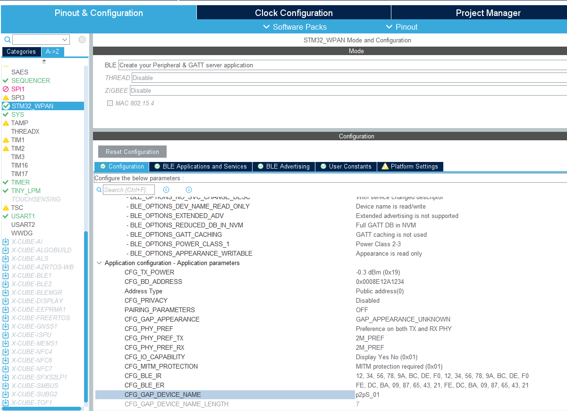
Customize Device Name
1
set same Device name = Local Name
2
iOS displays Local Name (advertising data) prior to a 1st connexion.
After a 1st connexion iOS displays Device name (thanks to look up table : associates BLE MAC @ & Device Name)

Slide 24
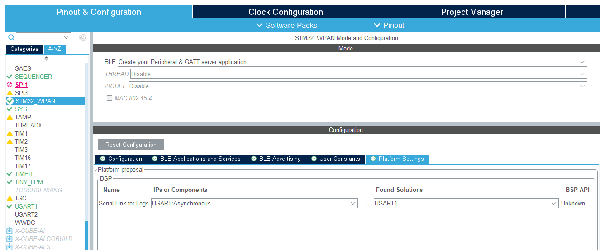
Platform Settings Trace & Logs: BSP settings
1
Anticipate Logs activation
Logs activation would require application configuration changes

Slide 25
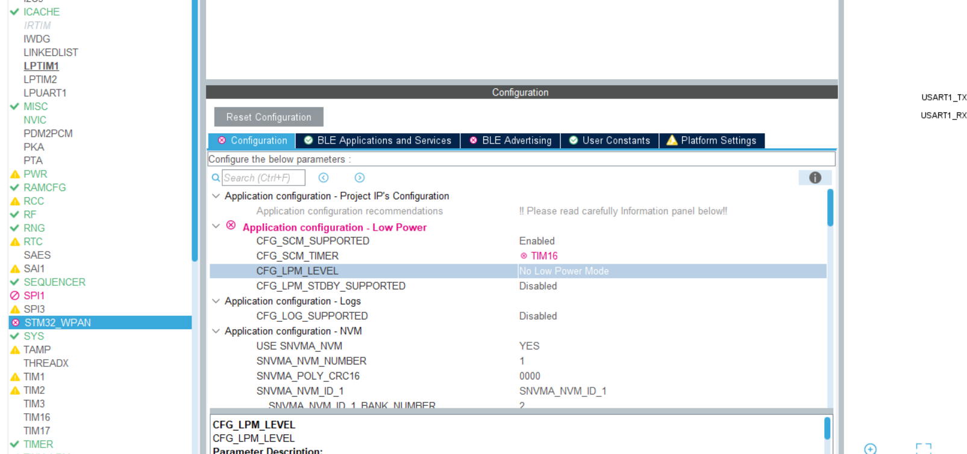
Configuration Disable: Low Power
1
As sanity check to avoid debugger connection

Slide 26
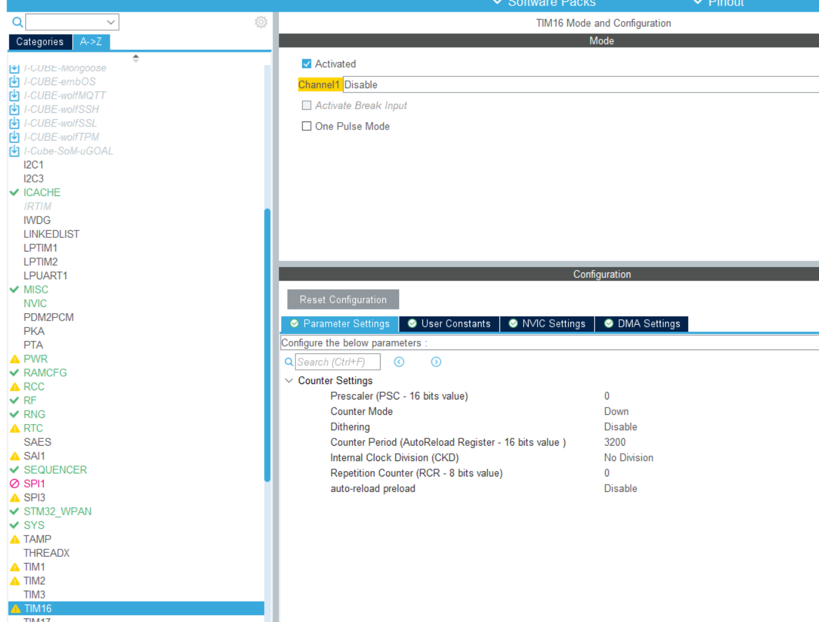
Configuration Enable: TIM16
2
1

Slide 27

Configuration completed What’s next : code generation ?
HW configuration
BLE parameters configuration
Code generation
Application code

Slide 28
Step 3 : Code generation and user application code

Slide 29
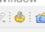
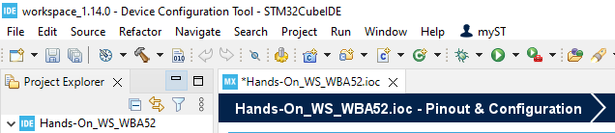
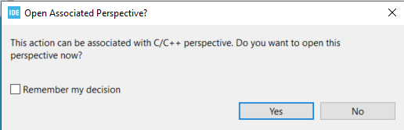
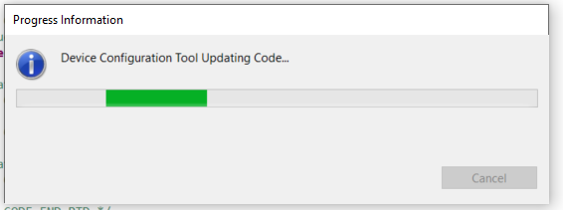
Code Generation
1

Slide 30
Configuration completed What’s next : code generation ?
HW configuration
BLE parameters configuration
Code generation
Application code

Slide 31
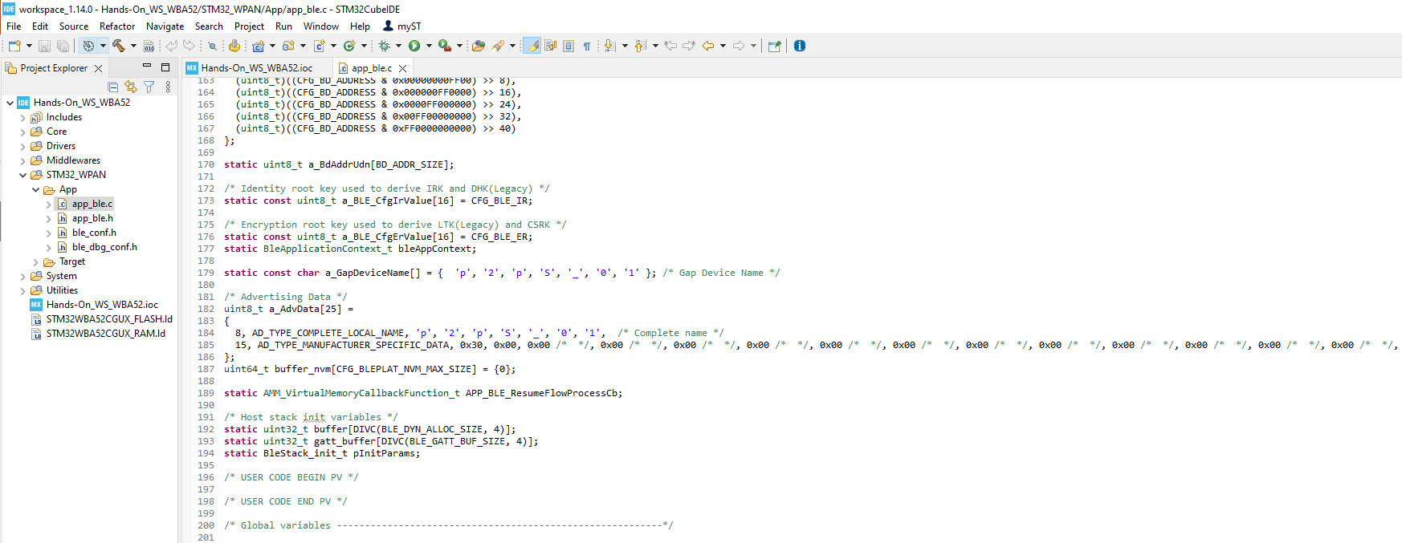
Here are our ADV data

Slide 32
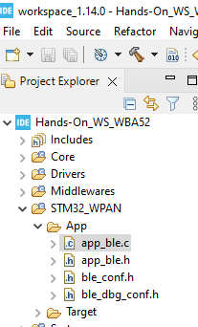

Open Project Add application code to move to discoverable (1/2)
Set device discoverable at init :
In app_ble.c > function APP_BLE_Init()
/* USER CODE BEGIN APP_BLE_Init_2 */
tBleStatus status;
status = aci_gap_set_discoverable(ADV_TYPE, ADV_INTERVAL_MIN,ADV_INTERVAL_MAX,
CFG_BD_ADDRESS_TYPE,
ADV_FILTER,
0, 0, 0, 0, 0, 0);
if (status != BLE_STATUS_SUCCESS) {
return;
}
status = aci_gap_delete_ad_type(AD_TYPE_TX_POWER_LEVEL);
if (status != BLE_STATUS_SUCCESS) {
return;
}
status = aci_gap_update_adv_data(sizeof(a_AdvData), (uint8_t*) a_AdvData);
if (status != BLE_STATUS_SUCCESS) {
return;
}
/* USER CODE END APP_BLE_Init_2 */
To accommodate the Advertising payload, remove the Tx power Adv Type set by stack
Search for “APP_BLE_Init_2”
Open Project
Add application code to move to discoverable
Build& Flash
Please refer to cheatsheet for copy/paste
Notes:
Please open & share as well cheatsheet STM32WBA Workshop (rristm.github.io)

Slide 33
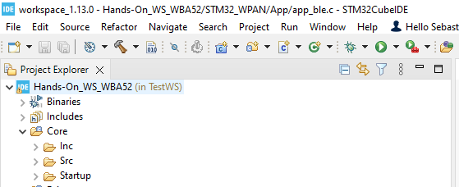
Open Project Add application code to move to discoverable (2/2)
Set device discoverable at disconnection :
In app_ble.c > SVCCTL_App_Notification - HCI_DISCONNECTION_COMPLETE_EVT_CODE
/* USER CODE BEGIN EVT_DISCONN_COMPLETE */
tBleStatus status;
status = aci_gap_set_discoverable(ADV_TYPE, ADV_INTERVAL_MIN,ADV_INTERVAL_MAX,
CFG_BD_ADDRESS_TYPE,
ADV_FILTER,
0, 0, 0, 0, 0, 0);
if (status != BLE_STATUS_SUCCESS) {
LOG_INFO_APP("==>> aci_gap_set_discoverable - fail, result: 0x%02X\n", status);
}
status = aci_gap_delete_ad_type(AD_TYPE_TX_POWER_LEVEL);
if (status != BLE_STATUS_SUCCESS) {
LOG_INFO_APP("==>> delete tx power level - fail, result: 0x%02X\n", status);
}
status = aci_gap_update_adv_data(sizeof(a_AdvData), (uint8_t*) a_AdvData);
if (status != BLE_STATUS_SUCCESS) {
LOG_INFO_APP("==>> Start Advertising Failed, result: 0x%02X\n", status);
}
/* USER CODE END EVT_DISCONN_COMPLETE */
1
Build
2
Flash
Search for “EVT_DISCONN_COMPLETE”
At disconnection, stack is not moving back to advertising, this is an application decision
Open Project
Add application code to move to discoverable
Build & Flash
Please refer to cheatsheet for copy/paste
Notes:
Please open & share as well cheatsheet STM32WBA Workshop (rristm.github.io)
why we have this GPIO_Init warning issue at build :
This function is declared directly in main.c => Should be done in main.h as when using STDBY,it is also called from stm32_lpm_if.c as it requires a full GPIO init
After build perform reset

Slide 34
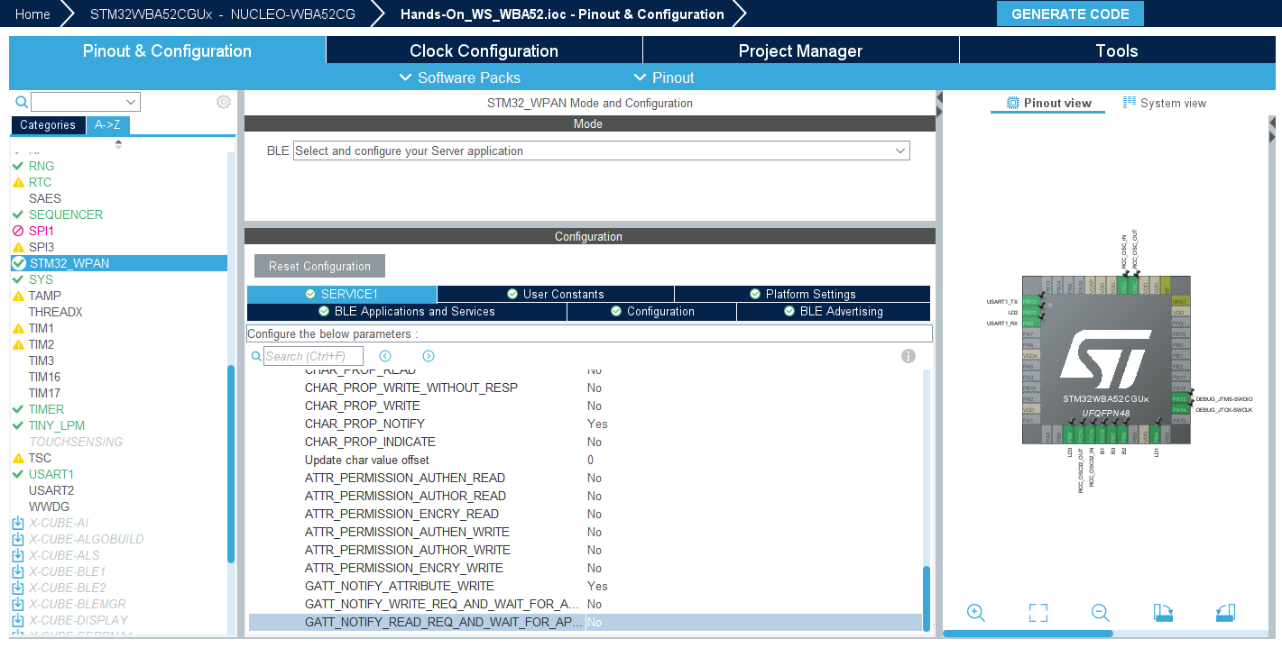
Bonus : Add debug capabilities
Move back to STM32CubeIDE/STM32CubeMX

Slide 35
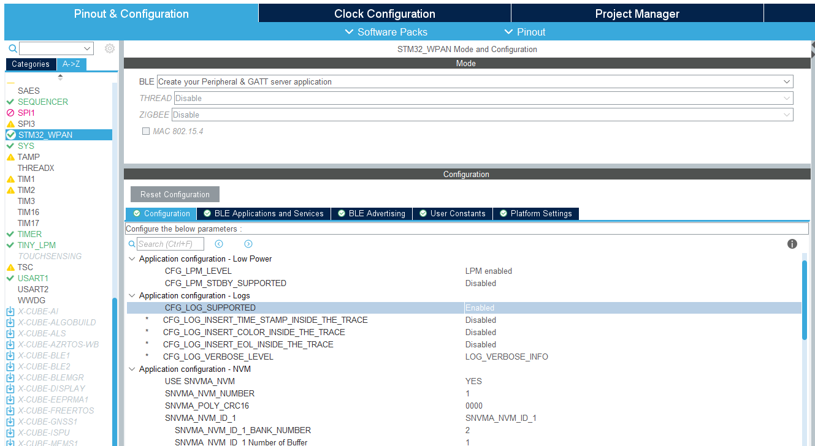
Application configuration Traces & logs
1

Slide 36

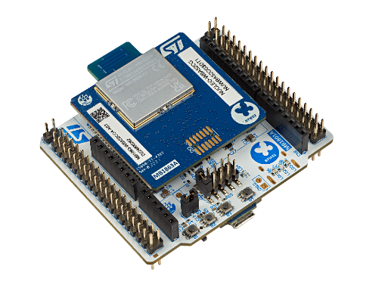
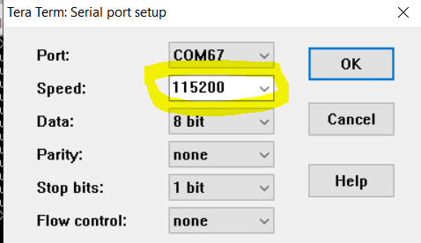
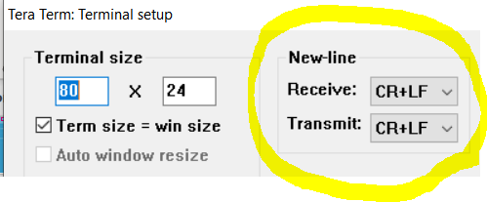
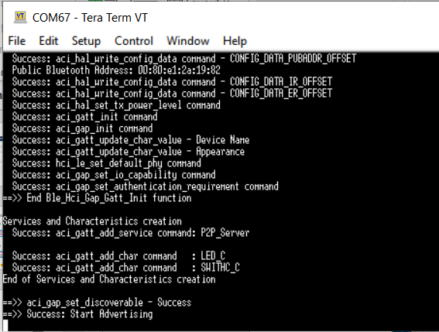
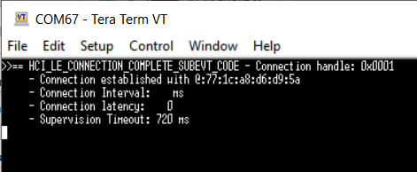
Open your App and Connect
TeraTerm
1
reset device
2
Connect

Slide 37
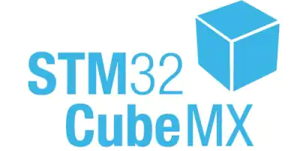
Takeaways What’s next
Hands-on#1 – Basic Bluetooth® Low Energy advertising device
Inherit of STM32 ecosystem and build a Bluetooth® Low Energy advertising device application in few steps
save .ioc project file
Hands-on#2 – Add Bluetooth® Low Energy profile application code
Extend existing application code to enable proprietary profile (P2P_Server)

